Slide 1
CSE 486/586 Distributed Systems Security --- 1
Steve Ko
Computer Sciences and Engineering
University at Buffalo

Slide 2
Recap
BFT
f faulty nodes → 3f + 1 total nodes
PBFT
Primary-backup state machine replication
Total ordering of requests
Handling primary failures
PBFT Clients
Waits for f + 1 replies with the same result
PBFT Replicas
Pre-prepare
Prepare
Commit
View change

Slide 3
Security Threats
Leakage: An unauthorized party gains access to a service or data.
Attacker obtains knowledge of a withdrawal or account balance
Tampering: Unauthorized change of data, tampering with a service
Attacker changes the variable holding your personal checking $$ total
Vandalism: Interference with proper operation, without gain to the attacker
Attacker does not allow any transactions to your account

Slide 4

Security Properties
Confidentiality: Concealment of information or resources
Authenticity: Identification and assurance of origin of info
Integrity: Trustworthiness of data or resources in terms of preventing improper and unauthorized changes
Availability: Ability to use desired info or resource
Non-repudiation: Offer of evidence that a party indeed is sender or a receiver of certain information
Access control: Facilities to determine and enforce who is allowed access to what resources (host, software, network, …)

Slide 5
Attack on Confidentiality
Eavesdropping
Unauthorized access to information
Packet sniffers and wiretappers (e.g. tcpdump)
Illicit copying of files and programs
A
B
Eavesdropper

Slide 6
Attach on Integrity
Tampering
Stop the flow of the message
Delay and optionally modify the message
Release the message again
A
B
Perpetrator

Slide 7
Attack on Authenticity
Fabrication
Unauthorized assumption of other’s identity
Generate and distribute objects under identity
A
B
Masquerader: from A

Slide 8
Attack on Availability
Destroy hardware (cutting fiber) or software
Modify software in a subtle way
Corrupt packets in transit
Blatant denial of service (DoS):
Crashing the server
Overwhelm the server (use up its resource)
A
B

Slide 9
Designing Secure Systems
Your system is only as secure as your weakest component!
Need to make worst-case assumptions about attackers:
exposed interfaces, insecure networks, algorithms and program code available to attackers, attackers may be computationally very powerful
Tradeoff between security and performance impact/difficulty
Typically design system to withstand a known set of attacks (Attack Model or Attacker Model)
It is not easy to design a secure system.
And it’s an arms race!

Slide 10
CSE 486/586 Administrivia
The last class on 4/30 (Monday)
Review of the semester
Project 3 out
Update
Please, please start now if you haven’t!
Deadline: 4/30 (Monday) @ 11:59PM
Final
5/7 (Monday), 3:30PM - 6:30PM
Norton 112

Slide 11
Cryptography
Comes from Greek word meaning “secret”
Primitives also can provide integrity, authentication
Cryptographers invent secret codes to attempt to hide messages from unauthorized observers
Modern encryption:
Algorithm public, key secret and provides security
May be symmetric (secret) or asymmetric (public)
Cryptographic algorithms goal
Given key, relatively easy to compute
Without key, hard to compute (invert)
“Level” of security often based on “length” of key
encryption
decryption
plaintext
ciphertext
plaintext

Slide 12
Three Types of Functions
Cryptographic hash Functions
Zero keys
Secret-key functions
One key
Public-key functions
Two keys

Slide 13
Cryptographic Hash Functions
Take message, m, of arbitrary length and produces a smaller (short) number, h(m)
Properties
Easy to compute h(m)
Pre-image resistance: Hard to find an m, given h(m)
“One-way function”
Second pre-image resistance: Hard to find two values that hash to the same h(m)
E.g. discover collision: h(m) == h(m’) for m != m’
Often assumed: output of hash fn’s “looks” random

Slide 14
How Hard to Find Collisions?
Birthday paradox
In a set of n random people, what’s the probability of two people having the same birthday?
Calculation
Compute probability of different birthdays
Random sample of n people taken from k=365 days

Slide 15
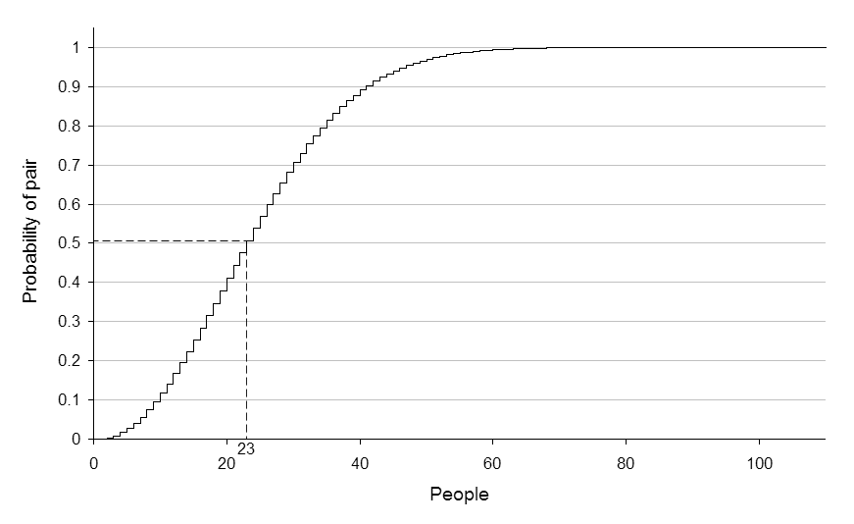
Birthday Paradox
Probability of no repetition:
P = 1 – (1) (1 - 1/365) (1 – 2/365) (1 – 3/365) … (1 – (n-1)/365)
P ≈ 1 – e^{-(n(n-1)/2k}
For p, it takes roughly sqrt(2k * ln(1/(1-p))) people to find two people with the same birthday.
With p = 50%,

Slide 16
How Many Bits for Hash?
If m bits, how many numbers do we need to find (weak) collision?
It’s not 2^{m}!
It takes 2^{m/2} to find weak collision
Still takes 2^{m} to find strong (pre-image) collision
64 bits, takes 2³² messages to search
MD5 (128 bits) considered too little
SHA-1 (160 bits) getting old

Slide 17
Example: Password
Password hashing
Can’t store passwords in a file that could be read
Concerned with insider attacks!
Must compare typed passwords to stored passwords
Does hash (typed) === hash (password)?
Actually, a salt is often used: hash (input || salt)
Avoids precomputation of all possible hashes in “rainbow tables” (available for download from file-sharing systems)

Slide 18
Symmetric (Secret) Key Crypto
Also: “conventional / private-key / single-key”
Sender and recipient share a common key
All classical encryption algorithms are private-key
Dual use: confidentiality (encryption) or authentication/integrity (message authentication code)
Was only type of encryption prior to invention of public-key in 1970’s
Most widely used
More computationally efficient than “public key”

Slide 19
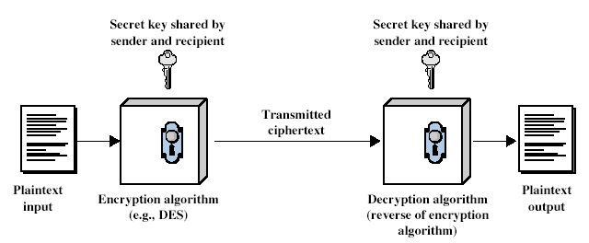
Symmetric Cipher Model

Slide 20
Requirements
Two requirements
Strong encryption algorithm
Secret key known only to sender/receiver
Goal: Given key, generate 1-to-1 mapping to ciphertext that looks random if key unknown
Assume algorithm is known (no security by obscurity)
Implies secure channel to distribute key

Slide 21
Uses
Encryption
For confidentiality
Sender: Compute C = AES_{K}(M) & Send C
Receiver: Recover M = AES’_{K}(C)
Message Authentication Code (MAC)
For integrity
Sender: Compute H = AES_{K}(SHA1 (M)) & Send <M, H>
Receiver: Computer H’ = AES_{K}(SHA1 (M)) & Check H’ == H

Slide 22
Public (Asymmetric) Key Crypto
Developed to address two key issues
Key distribution: secure communication without having to trust a key distribution center with your key
Digital signature: verifying that a message comes from the claimed sender without prior establishment
Public invention Diffie & Hellman in 1976
Known earlier to classified community

Slide 23
Public (Asymmetric) Key Crypto
Involves two keys
Public key: can be known to anybody, used to encrypt and verify signatures
Private key: should be known only to the recipient, used to decrypt and sign signatures
Asymmetric
Can encrypt messages or verify signatures w/o ability to decrypt msgs or create signatures
If “one-way function” goes c ← F(m), then public-key encryption is a “trap-door” function:
Easy to compute c ← F(m)
Hard to compute m ← F⁻¹(c) without knowing k
Easy to compute m ← F⁻¹(c,k) by knowing k

Slide 24
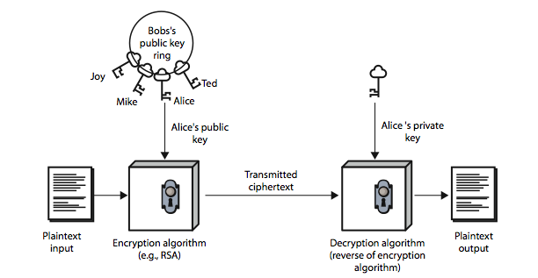
Public (Asymmetric) Key Crypto

Slide 25
Security of Public Key Schemes
Like private key schemes, brute force search possible
But keys used are too large (e.g., >= 1024 bits)
Security relies on a difference in computational difficulty b/w easy and hard problems
RSA: exponentiation in composite group vs. factoring
ElGamal/DH: exponentiation vs. discrete logarithm in prime group
Hard problems are known, but computationally expensive
Requires use of very large numbers
Hence is slow compared to private key schemes
RSA-1024: 80 us / encryption; 1460 us / decryption [cryptopp.com]
AES-128: 109 MB / sec = 1.2us / 1024 bits

Slide 26
(Simple) RSA Algorithm
Security due to cost of factoring large numbers
Factorization takes O(e ^{log n log log n}) operations (hard)
Exponentiation takes O((log n)³) operations (easy)
To encrypt a message M the sender:
Obtain public key {e,n}; compute C = Me mod n
To decrypt the ciphertext C the owner:
Use private key {d,n}; computes M = C^{d} mod n
Note that msg M must be smaller than the modulus n
Otherwise, hybrid encryption:
Generate random symmetric key r
Use public key encryption to encrypt r
Use symmetric key encryption under r to encrypt M

Slide 27
Typical Applications
Secure digest
A fixed-length that characterizes an arbitrary-length message
Typically produced by cryptographic hash functions, e.g., SHA-1 or MD5.
Digital signature
Verifies a message or a document is an unaltered copy of one produced by the signer
Signer: compute H = RSA_{K}(SHA1(M)) & send <M, H>
Verifier: compute H’ = SHA1(RSA_{K’}(H)) & verify H == H’
MAC (Message Authentication Code)
Digital signatures with secret keys
Verifies the authenticity of a message
Sender: compute H = AES_{K}(SHA1 (M)) & send <M, H>
Receiver: computer H’ = AES_{K}(SHA1 (M)) & check H’ == H

Slide 28
Summary
Security properties
Confidentiality, authenticity, integrity, availability, non-repudiation, access control
Three types of functions
Cryptographic hash, symmetric key crypto, asymmetric key crypto
Applications
Secure digest, digital signature, MAC, digital certificate

Slide 29
Acknowledgements
These slides contain material developed and copyrighted by Indranil Gupta (UIUC), Jennifer Rexford (Princeton) and Michael Freedman (Princeton).

